Slide 1

Computer Networks
The Network Layer
IPv4 & IPv6 Header

Slide 2
IPv4
The Internet Protocol version 4 (IPv4) is the delivery mechanism used by the TCP/IP protocols.
Topics discussed in this section:
Datagram
Fragmentation
Checksum
Options

Slide 3
Network Layer: Internet
host, router network layer functions:
transport layer: TCP, UDP
IP protocol
datagram format
addressing
packet handling conventions
Path-selection algorithms: implemented in
routing protocols (OSPF, BGP)
SDN controller
network
layer
forwarding
table
ICMP protocol
error reporting
router “signaling”
link layer
physical layer

Slide 4


Slide 5
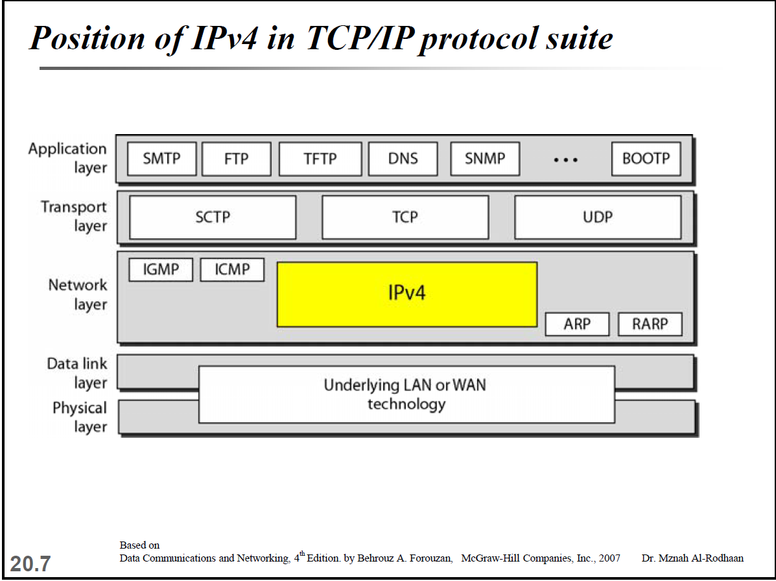

Slide 6
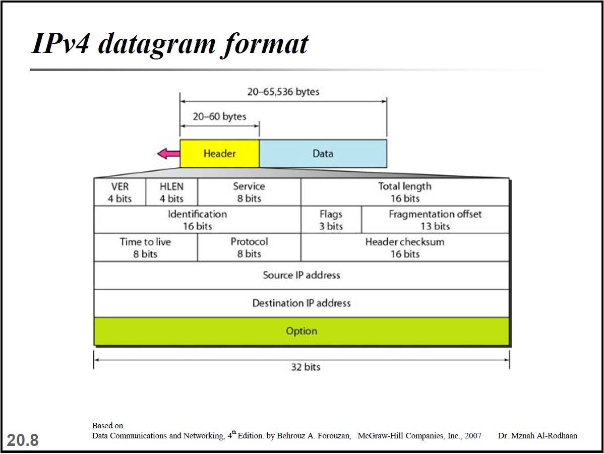

Slide 7
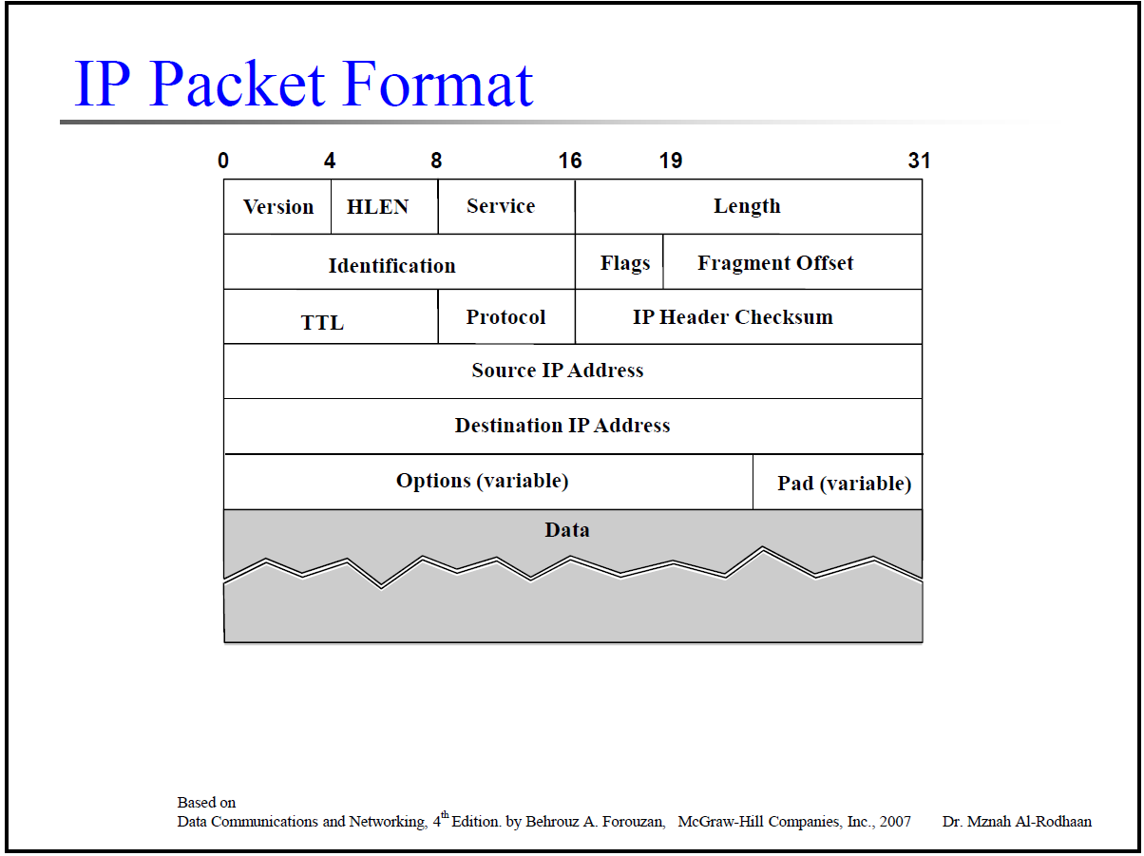

Slide 8
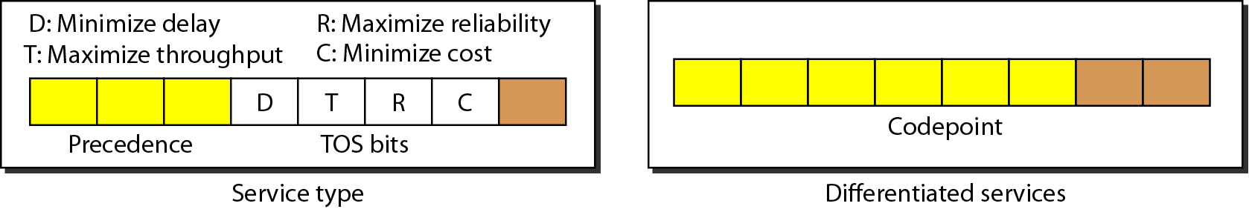
Figure 20.6 Service type or differentiated services

Slide 9
Table 20.1 Types of service

Slide 10
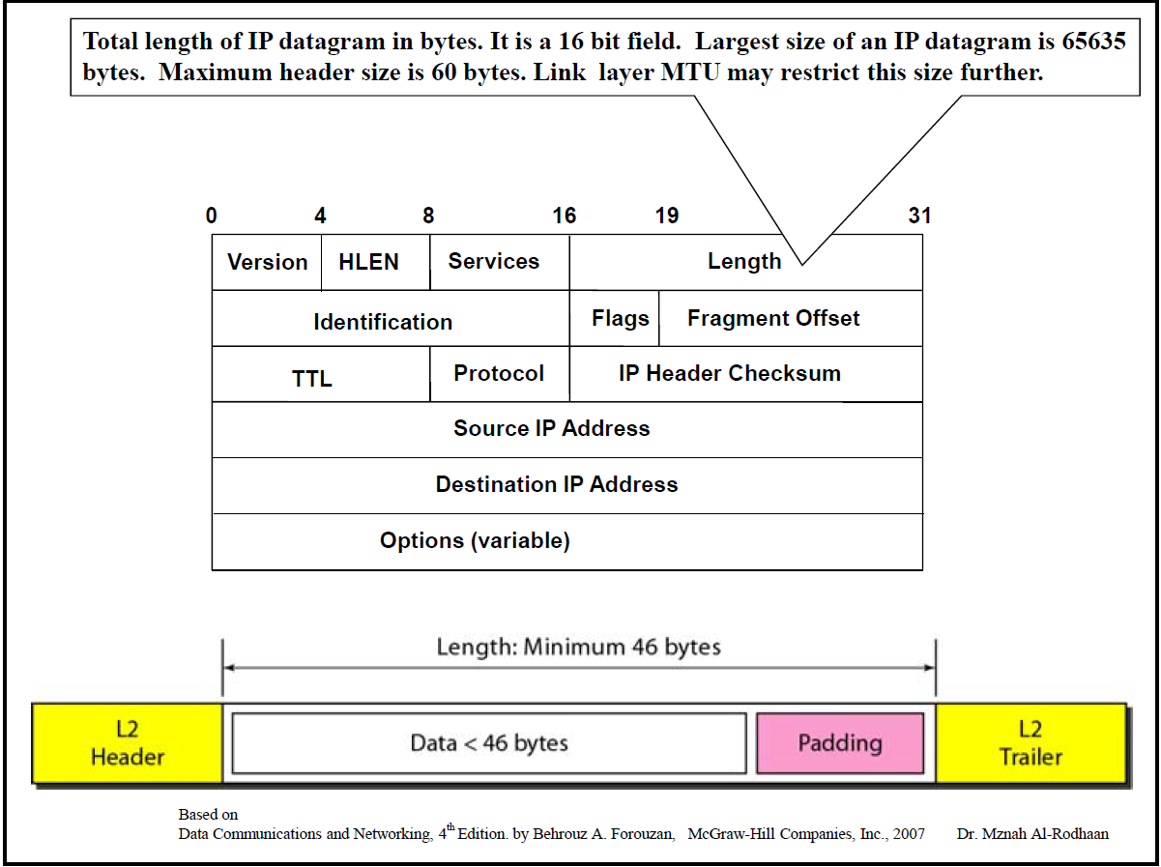

Slide 11
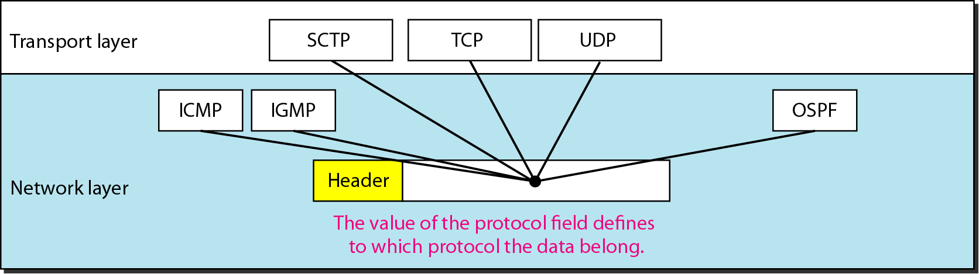
Figure 20.8 Protocol field and encapsulated data

Slide 12
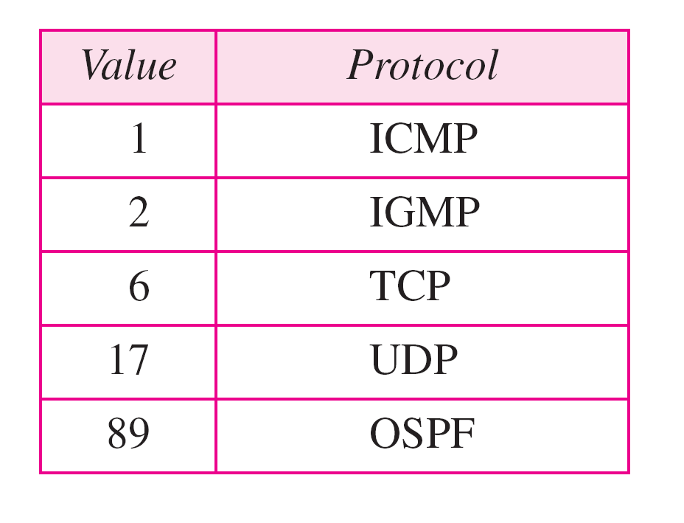
Table 20.4 Protocol values

Slide 13
Example
An IPv4 packet has arrived with the first 8 bits as shown:
01000010
The receiver discards the packet. Why?
Notes:
Solution
There is an error in this packet. The 4 leftmost bits (0100) show the version, which is correct. The next 4 bits (0010) show an invalid header length (2 × 4 = 8). The minimum number of bytes in the header must be 20. The packet has been corrupted in transmission

Slide 14
Example
In an IPv4 packet, the value of HLEN is 5, and the value of the total length field is 0x0028. How many bytes of data are being carried by this packet?
Notes:
Solution
The HLEN value is 5, which means the total number of bytes in the header is 5 × 4, or 20 bytes (no options). The total length is 40 bytes, which means the packet is carrying 20 bytes of data (40 − 20).

Slide 15
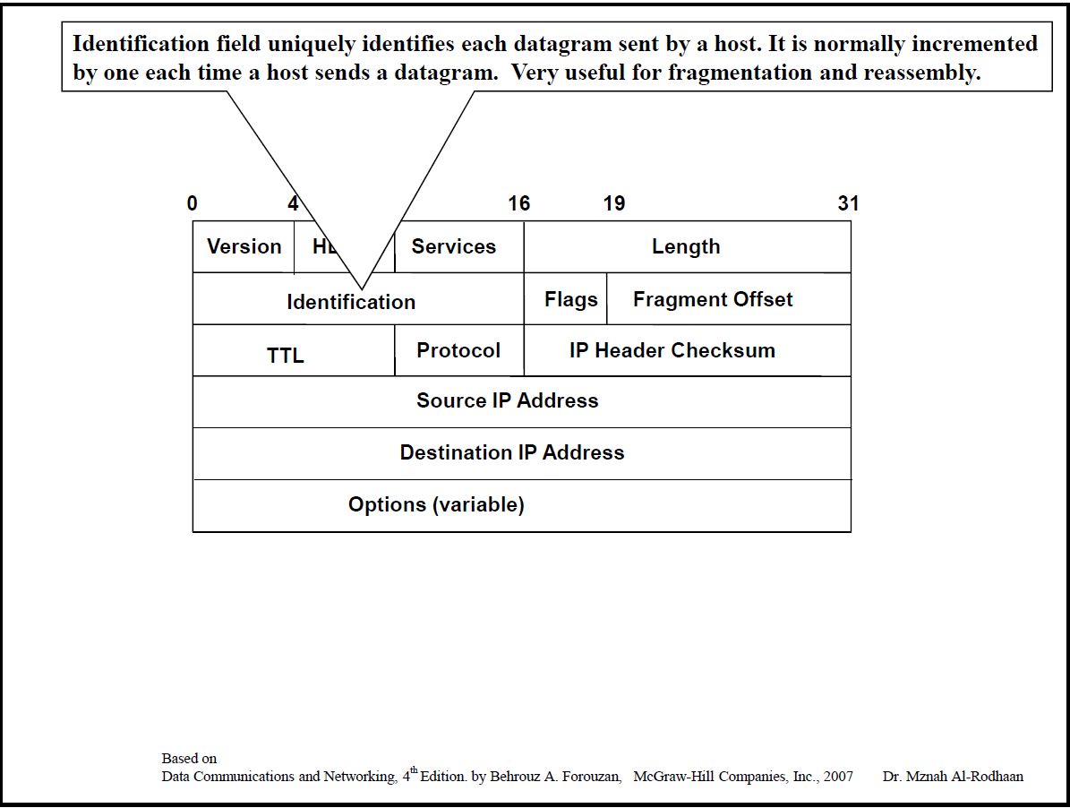

Slide 16

Figure 20.10 Flags used in fragmentation

Slide 17
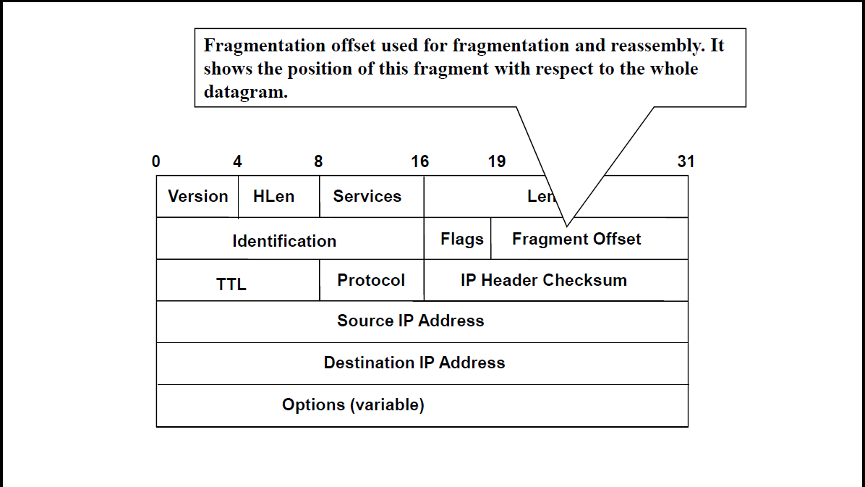

Slide 18
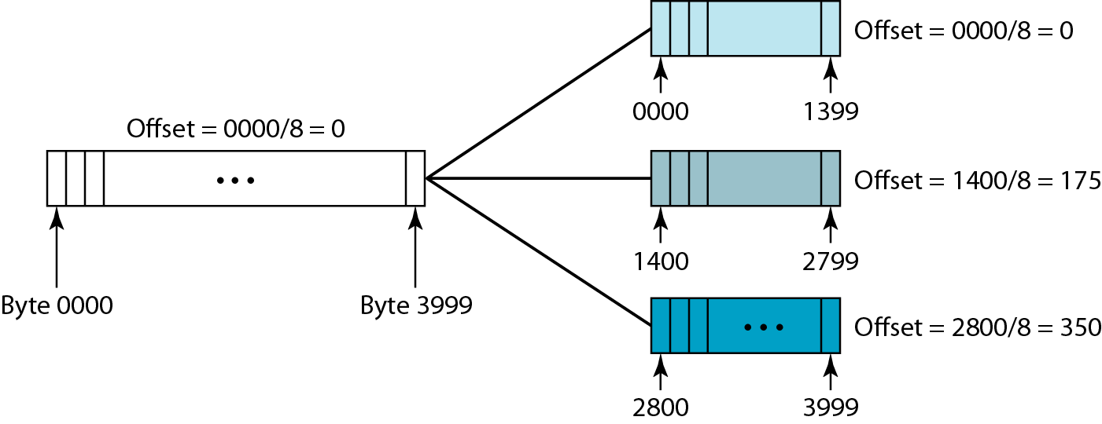
Figure 20.11 Fragmentation example

Slide 19
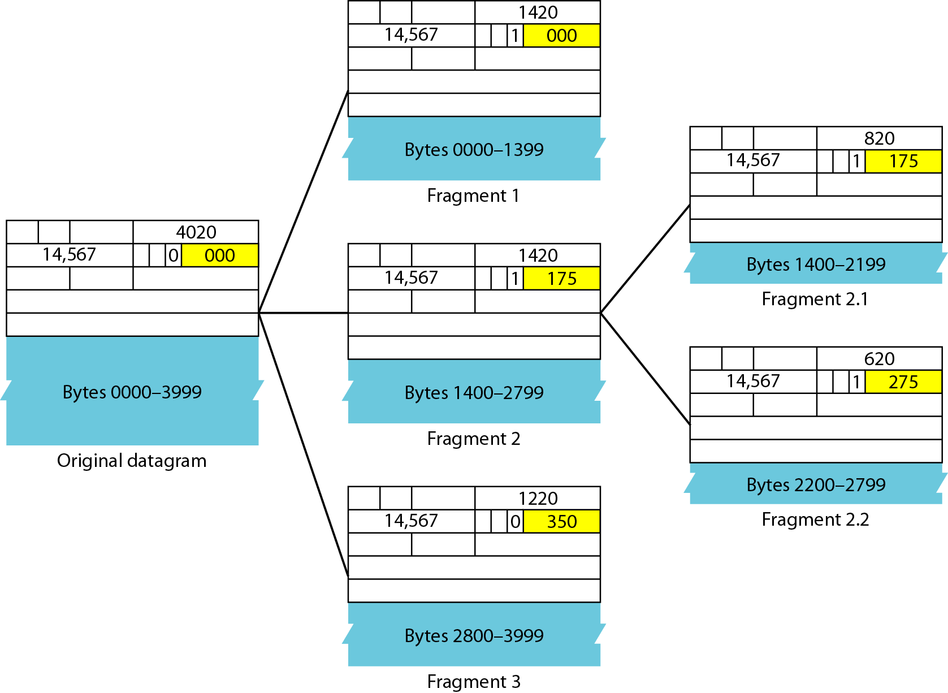
Figure 20.12 Detailed fragmentation example

Slide 20
Example
A packet has arrived with an M bit value of 0. Is this the first fragment, the last fragment, or a middle fragment? Do we know if the packet was fragmented?
Notes:
Solution
If the M bit is 0, it means that there are no more fragments; the fragment is the last one. However, we cannot say if the original packet was fragmented or not. A non-fragmented packet is considered the last fragment.

Slide 21
Example
A packet has arrived with an M bit value of 1 and a fragmentation offset value of 0. Is this the first fragment, the last fragment, or a middle fragment?
Notes:
Solution
Because the M bit is 1, it is either the first fragment or a middle one. Because the offset value is 0, it is the first fragment.

Slide 22
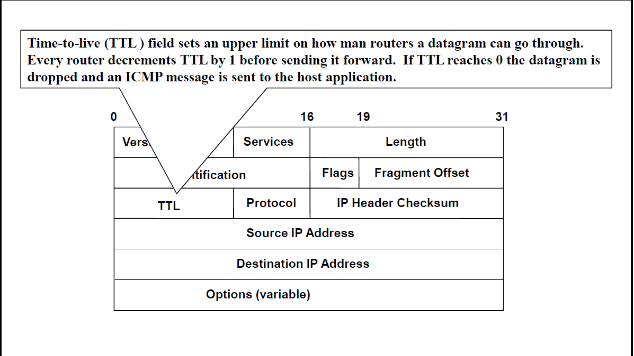

Slide 23
Example
An IPv4 packet has arrived with the first few hexadecimal digits as shown.
0x45000028000100000102 . . .
How many hops can this packet travel before being dropped? The data belong to what upper-layer protocol?
Notes:
Solution
To find the time-to-live field, we skip 8 bytes. The time-to-live field is the ninth byte, which is 01. This means the packet can travel only one hop. The protocol field is the next byte (02), which means that the upper-layer protocol is IGMP.

Slide 24
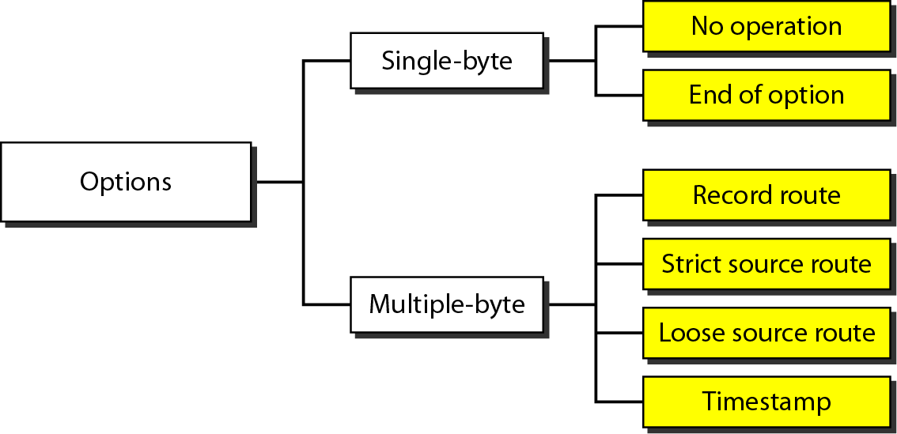
Figure 20.14 Taxonomy of options in IPv4

Slide 25
IPv6
The network layer protocol in the TCP/IP protocol suite is currently IPv4. Although IPv4 is well designed, data communication has evolved since the inception of IPv4 in the 1970s. IPv4 has some deficiencies that make it unsuitable for the fast-growing Internet.
Topics discussed in this section:
Advantages Packet Format Extension Headers

Slide 26
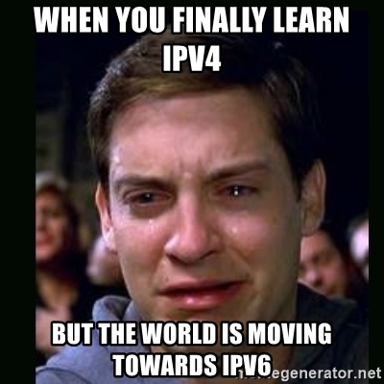

Slide 27
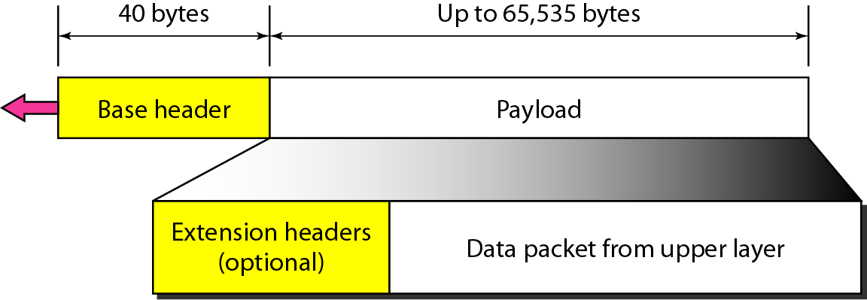
Figure 20.15 IPv6 datagram header and payload

Slide 28
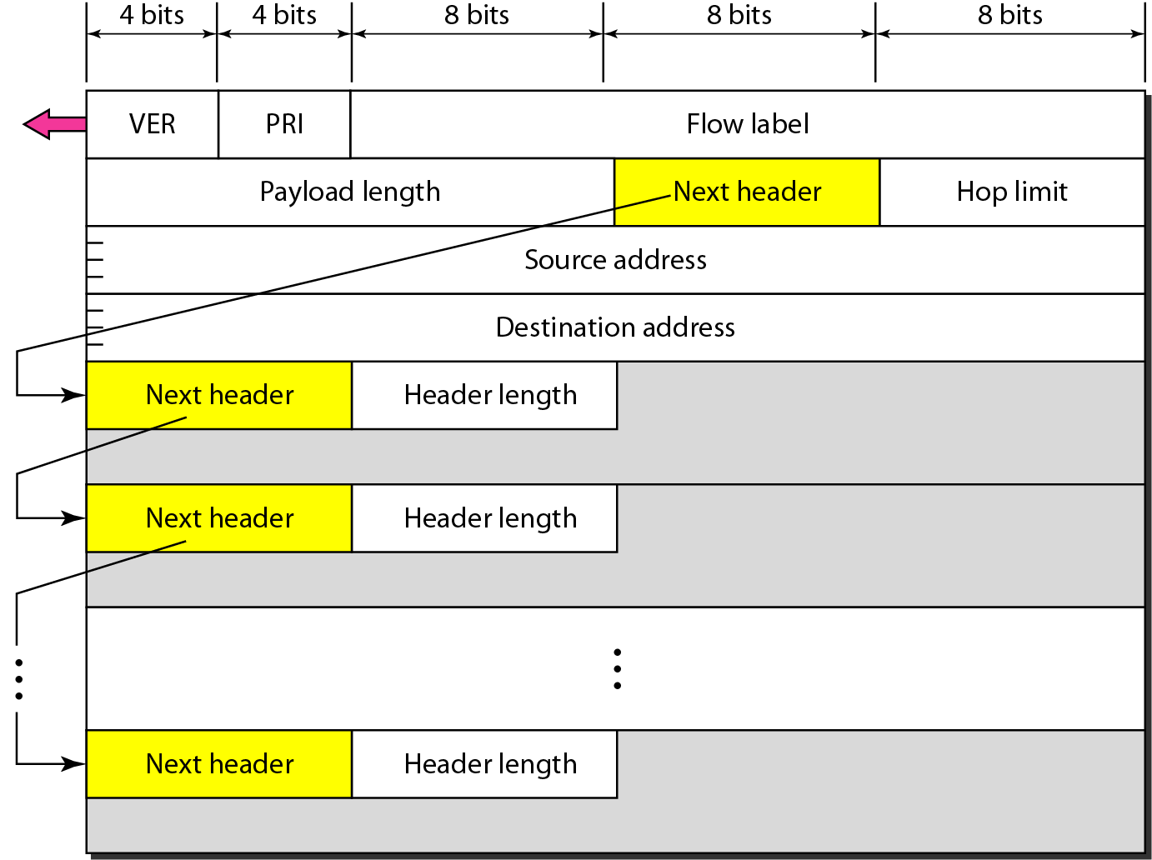
Figure 20.16 Format of an IPv6 datagram

Slide 29
Table 20.6 Next header codes for IPv6

Slide 30
Table 20.7 Priorities for congestion-controlled traffic

Slide 31
Table 20.8 Priorities for noncongestion-controlled traffic

Slide 32
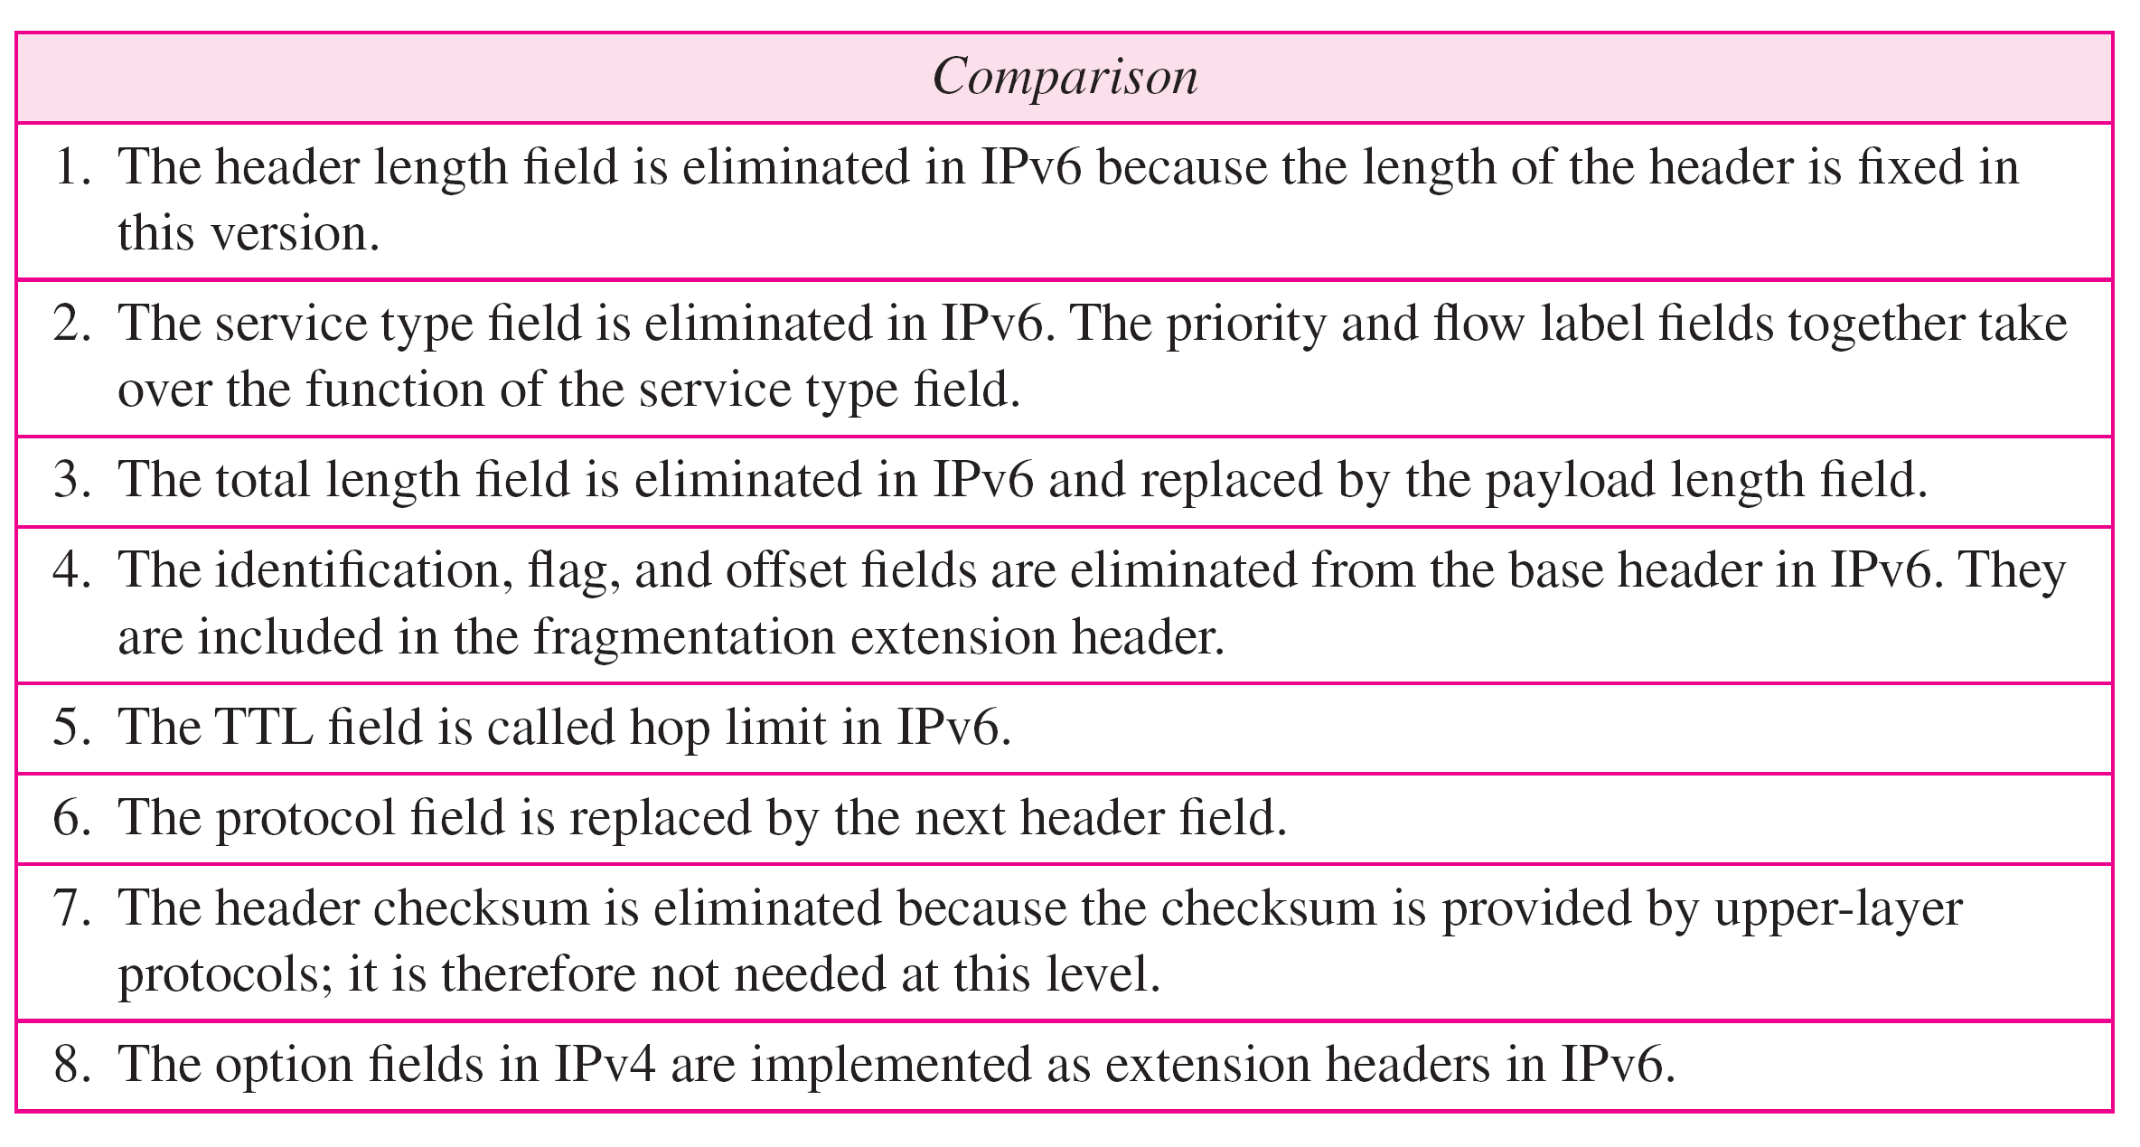
Table 20.9 Comparison between IPv4 and IPv6 packet headers

Slide 33
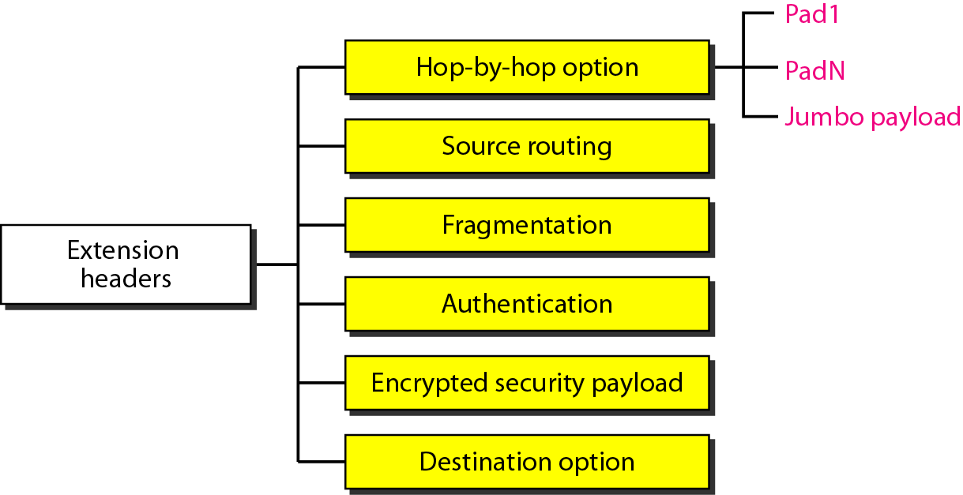
Figure 20.17 Extension header types

Slide 34
Table 20.10 Comparison between IPv4 options and IPv6 extension headers

Slide 35
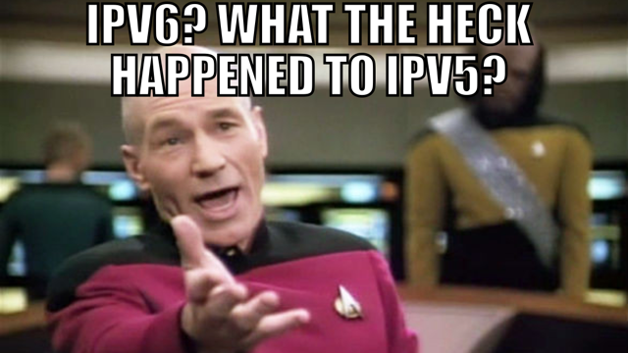

Slide 36
TRANSITION FROM IPv4 TO IPv6
Because of the huge number of systems on the Internet, the transition from IPv4 to IPv6 cannot happen suddenly. It takes a considerable amount of time before every system in the Internet can move from IPv4 to IPv6. The transition must be smooth to prevent any problems between IPv4 and IPv6 systems.
Topics discussed in this section:
Dual Stack Tunneling Header Translation

Slide 37
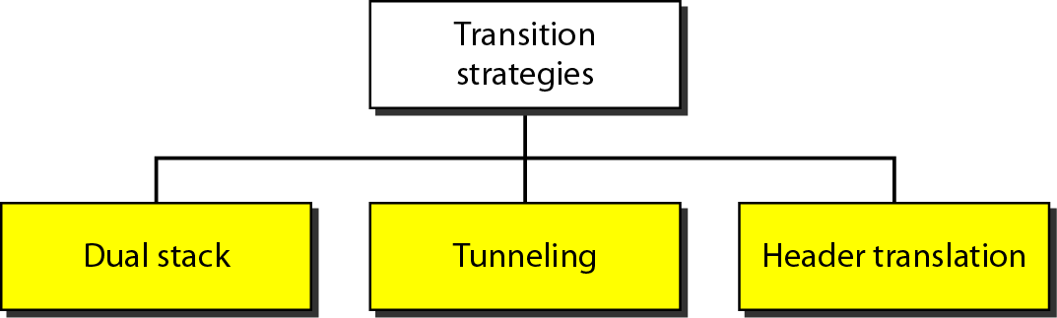
Figure 20.18 Three transition strategies

Slide 38
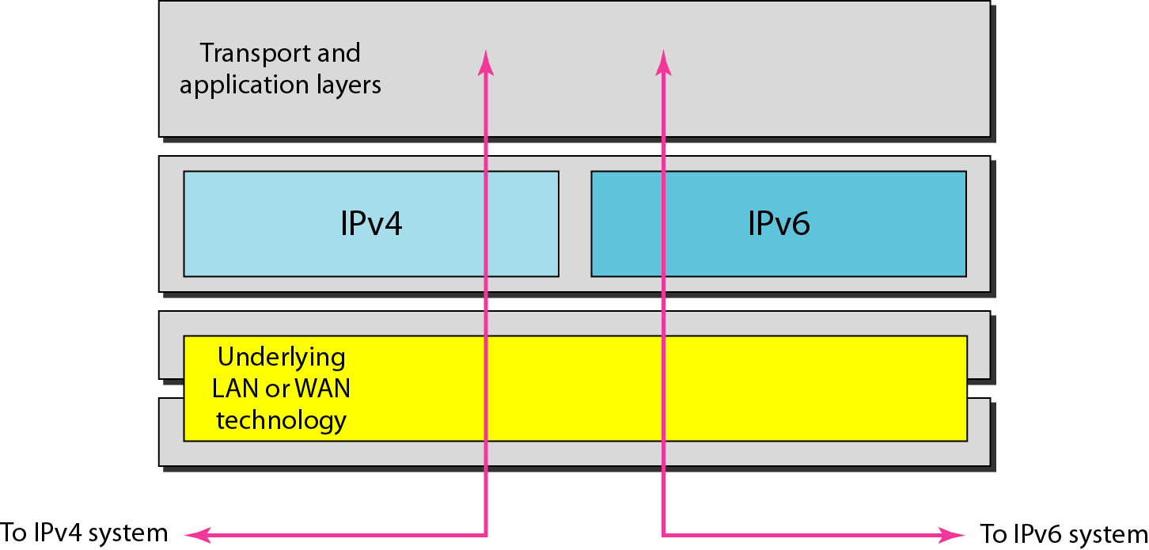
Figure 20.19 Dual stack

Slide 39
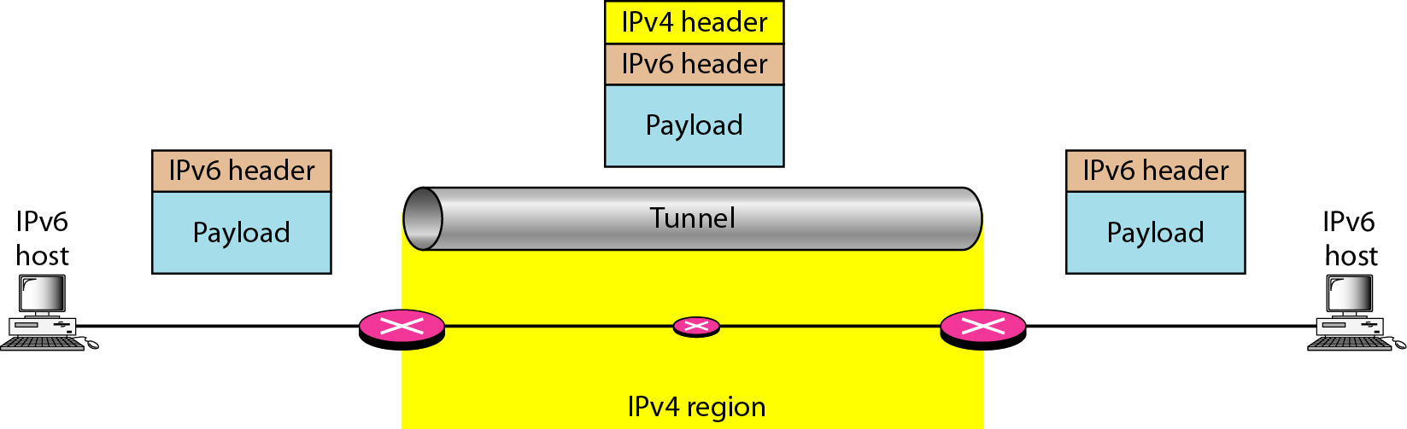
Figure 20.20 Tunneling strategy

Slide 40
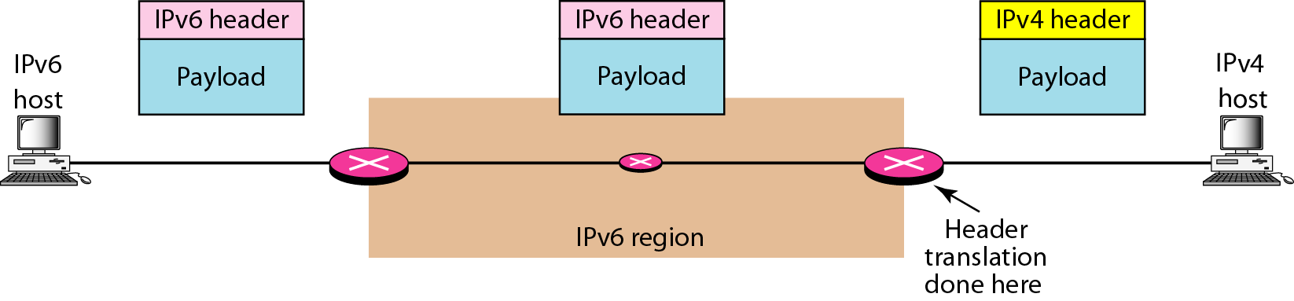
Figure 20.21 Header translation strategy

Slide 41
Table 20.11 Header translation

Slide 42
22-1 IPv6 Addressing
The main reason for migration from IPv4 to IPv6 is the small size of the address space in IPv4. In this section, we show how the huge address space of IPv6 prevents address depletion in the future. We also discuss how the new addressing responds to some problems in the IPv4 addressing mechanism. An IPv6 address is 128 bits or 16 bytes (octets) long, four times the address length in IPv4.

Slide 43
22.22.1 Representation
A computer normally stores the address in binary, but it is clear that 128 bits cannot easily be handled by humans. Several notations have been proposed to represent IPv6 addresses when they are handled by humans. The following shows two of these notations: binary and colon hexadecimal.

Slide 44
22.22.2 Address Space
The address space of IPv6 contains 2¹²⁸ addresses. This address space is 2⁹⁶ times the IPv4 address—definitely no address depletion—as shown, the size of the space is

Slide 45
22.22.3 Address Space Allocation
Like the address space of IPv4, the address space of IPv6 is divided into several blocks of varying size and each block is allocated for a special purpose. Most of the blocks are still unassigned and have been set aside for future use. Table 22.1 shows only the assigned blocks. In this table, the last column shows the fraction each block occupies in the whole address space..
Notes:
Unicast, AnyCast, Multicast

Slide 46
Table 22.1: Prefixes for assigned IPv6 addresses
22.46

Slide 47
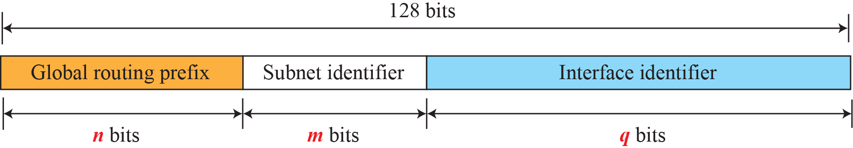
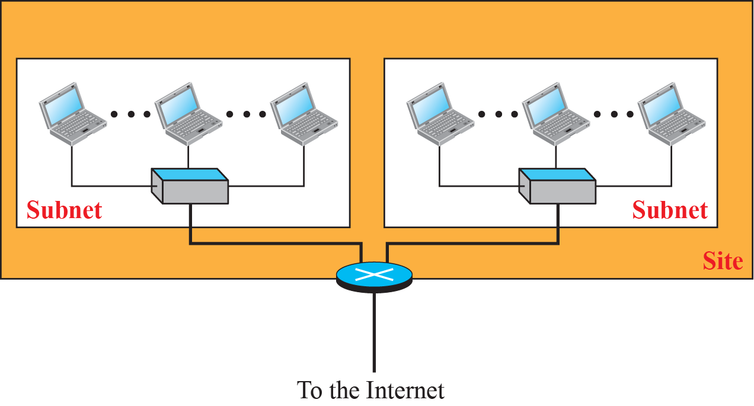
Figure 22.1: Global unicast address

Slide 48
Figure 22.4: Special addresses

Slide 49
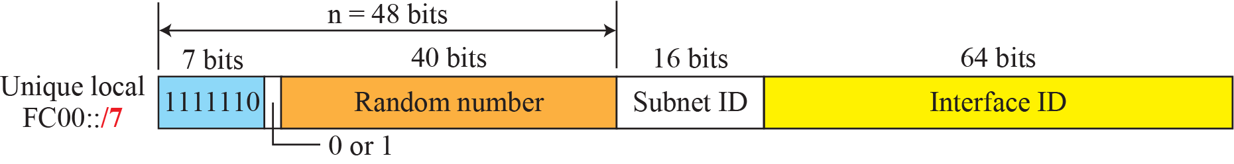
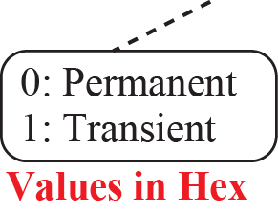
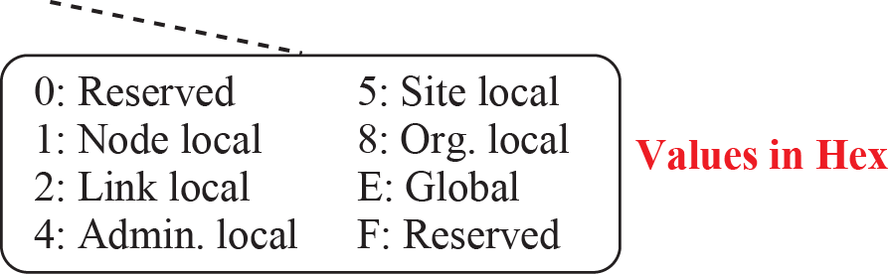
Figure 22.5: Unique local unicast block
Notes:
Autoconfiguration

Slide 50
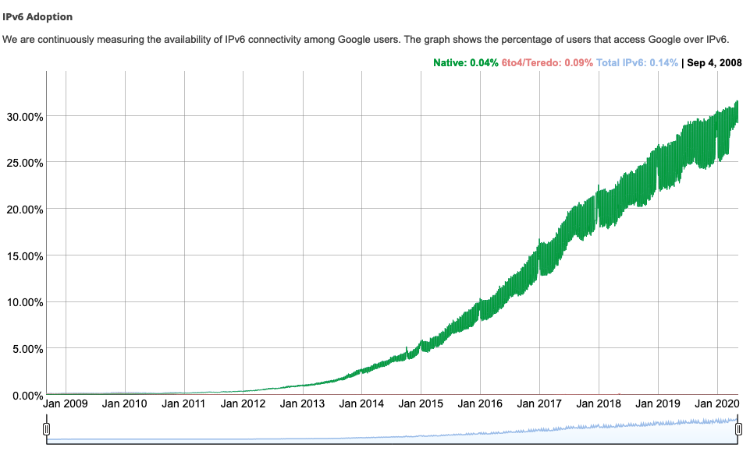
IPv6: adoption
Google¹: ~ 30% of clients access services via IPv6
NIST: 1/3 of all US government domains are IPv6 capable
¹ https://www.google.com/intl/en/ipv6/statistics.html

Slide 51
IPv6: adoption
Google¹: ~ 30% of clients access services via IPv6
NIST: 1/3 of all US government domains are IPv6 capable
Long (long!) time for deployment, use
25 years and counting!
think of application-level changes in last 25 years: WWW, social media, streaming media, gaming, telepresence, …
Why?
¹ https://www.google.com/intl/en/ipv6/statistics.html

